Slide 1
"I think there is a world market for maybe five computers." -- Thomas Watson, president of IBM, 1943
8-bit addressing
2^8 = 256
Fortunately saved by memory model from that mistake.

Slide 2
Classed Routing
First Octet Starting with 1 to 126 – Class A – 16 Million Addresses
First Octet Starting with 128 to 191 – Class B – 65 Thousand Addresses
First Octet Starting with 192 to 223 – Class C – 256 Addresses
No flexibility in allocation size.
MAJOR waste!

Slide 3
Some Flexibilty
RFC 1338 – June 1992 – Allowed Class A & B allocations to be broken down into B & C sized supernets and subnets – only along “byte boundaries.”
RFC 1519 – September 1993 – CIDR: Allowed all usable IP space to be broken down into supernets & subnets of any size.
Now we’re getting somewhere!

Slide 4
Not really Four Billion IP Addresses
~13% of the 4 Billion reserved for various administrative functions.
Every time you allocate a subnet, you waste more space.
Inflexible network sizing - If you allocate a subnet that’s big enough, it’s likely too big and wasting more space.

Slide 5
The Big Concept
2,251,799,813,685,248 (2.3 quadrillion) prefixes.
Each with 18,446,744,073,709,551,616 (18.4 quintillion) Global Unicast IP addresses.
All the world’s devices on one network, or. . .
A network for every device.
Enough IP addresses and networks to supply a colonized solar system for 250 years.

Slide 6
Advocacy
Be an IPv6 Champion!

Slide 7


Slide 8
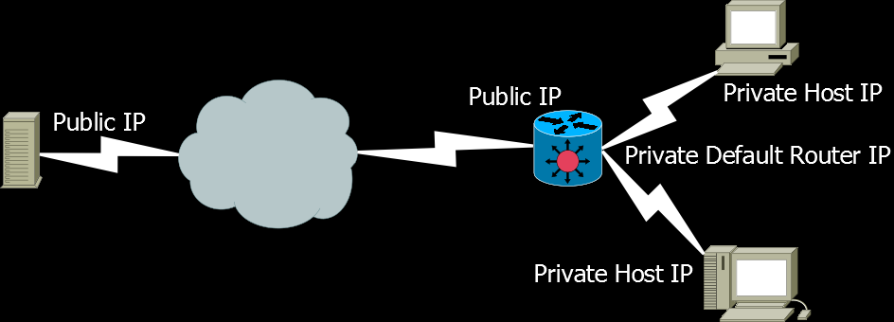
NAT – Why it’s bad.

Slide 9
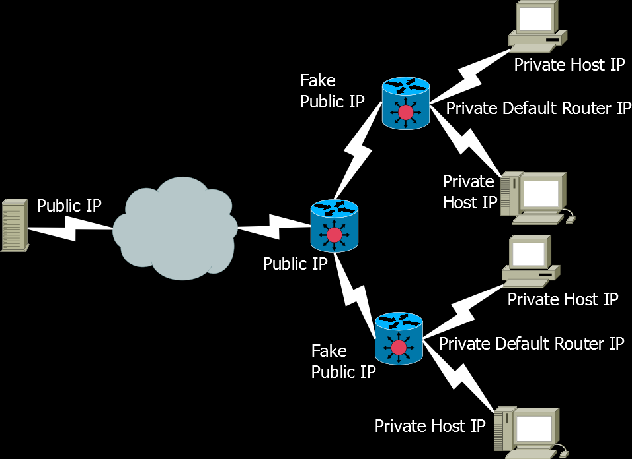
cgNAT – Why it’s worse!

Slide 10
You may already be a victim! 100.64.0.0/10 100.64.0.1 – 100.127.255.254 (RFC-6598)

Slide 11
Cool IPv6 Feature
One Size Fits All Prefixing
v4 /22 network - ~1024 host IPs.
v4 /23 network - ~512 host IPs.
v6 /64 Prefix - 18.4 quintillion host IPs.
Big enough to support features like SLAAC.
Big enough for any number of hosts you could possibly add.

Slide 12
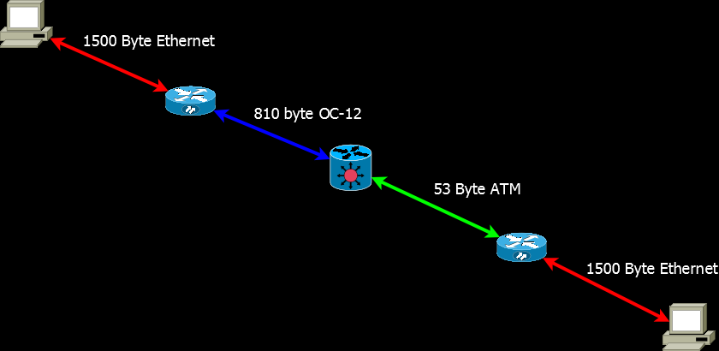
Cool IPv6 Feature Path MTU Discovery

Slide 13

Cool IPv6 Feature
IPsec – IPv6 built for it from the ground up.

Slide 14
Common IPv6 Prefixing
Common Autonomous System Prefix Allocations
/32 – issued to Network Providers: ~4.3 Billion /64 Host Prefixes
/48 – issued to Businesses and Individuals: 65.5 Thousand /64 Host Prefixes
Common Sub-Prefixes Issued Within Organizations
/56 – issued to large Branch Offices 256 /64 Host Prefixes
/60 – issued to small Branch Offices 16 /64 Host Prefixes
and to households at better ISPs
/64 – issued to households at worse ISPs Just one /64 Prefix

Slide 15
DNS for IPv6
Only One IPv6-Specific DNS Record Type
AAAA – Resolves FQDNs (Fully Qualified Domain Names) to IP Addresses
Inside a Forward Zone like: example.com.
ns1 IN AAAA 3ffe:420:1101:6::a
Ns2 IN AAAA 3ffe:420:2041:5000::a

Slide 16
DNS for IPv6
PTR – Resolves IP Addresses to FQDNS
Flexibility in Reverse Zone Allocation
Zone: 1.4.0.2.0.2.4.0.e.f.f.3.ip6.arpa.
a.0.0.0.0.0.0.0.0.0.0.0.0.0.0.0.0.0.0.5 IN PTR ns2.example.com.
Zone: 6.0.0.0.1.0.1.1.0.2.4.0.e.f.f.3.ip6.arpa.
a.0.0.0.0.0.0.0.0.0.0.0.0.0.0.0 IN PTR ns1.example.com.

